Slide 1
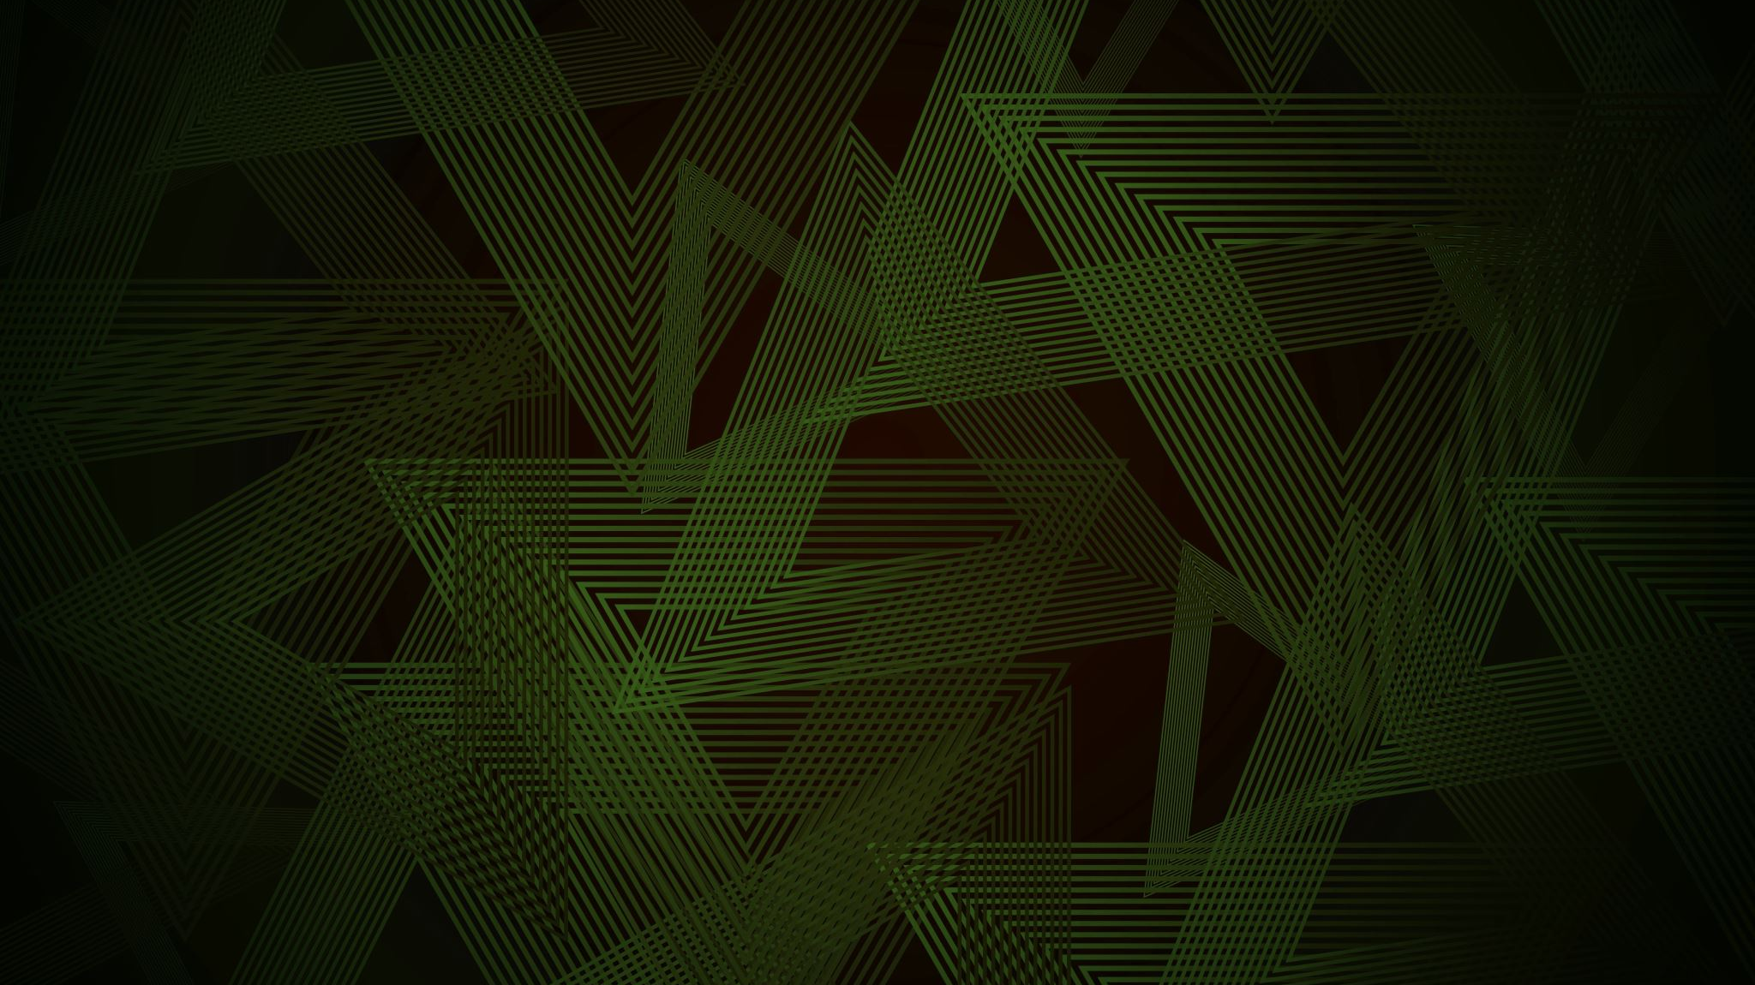
Art Bible: Zombie Platformer
By James Webster

Slide 2
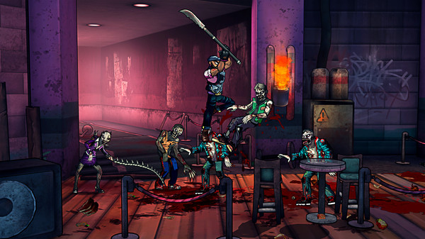
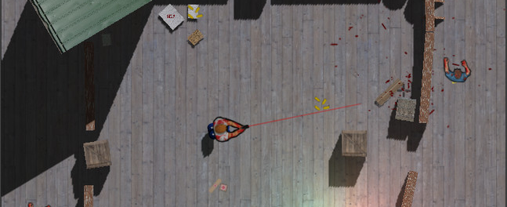
Overview: Zombie Platformer
3D Zombie Shooter with Moving Platforms

Slide 3
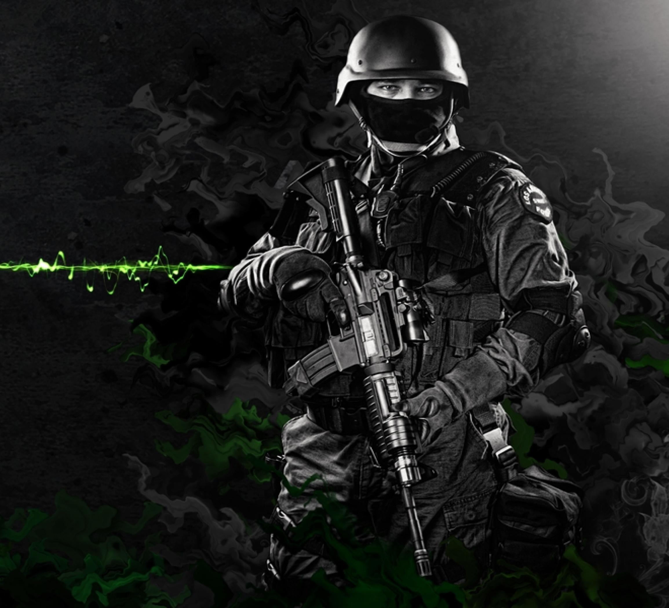
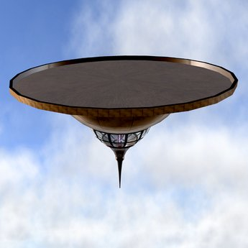
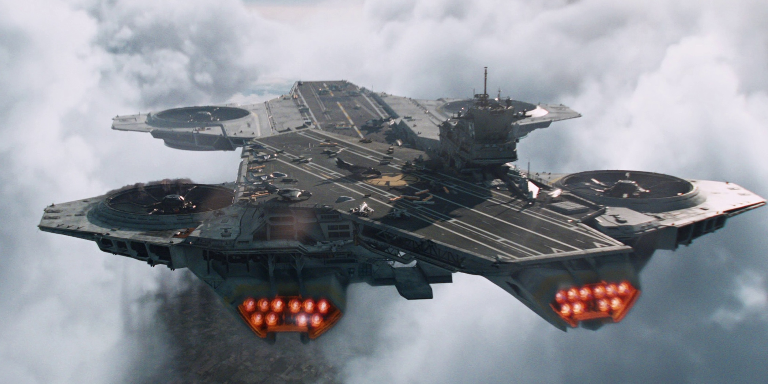
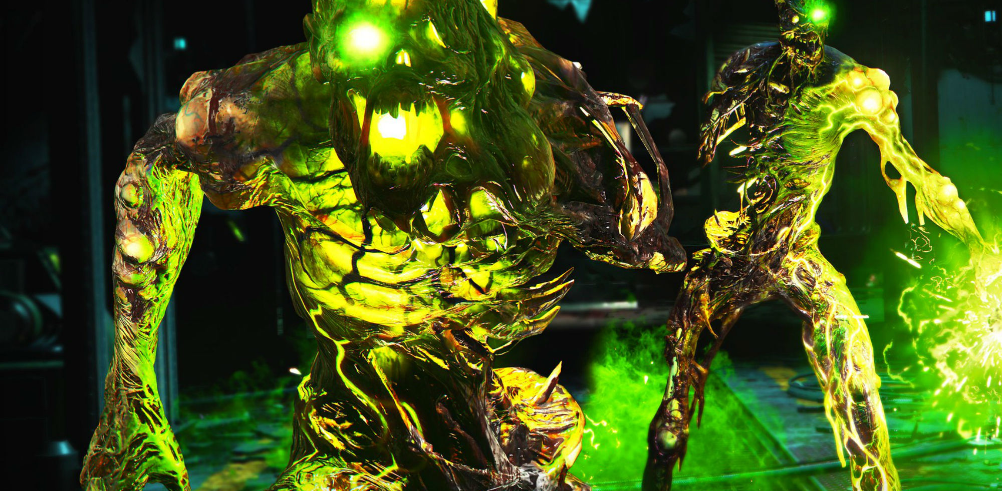
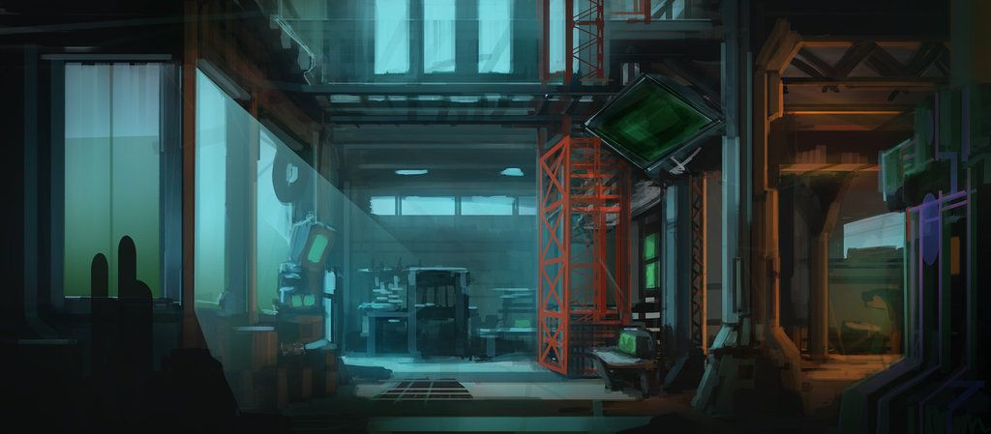
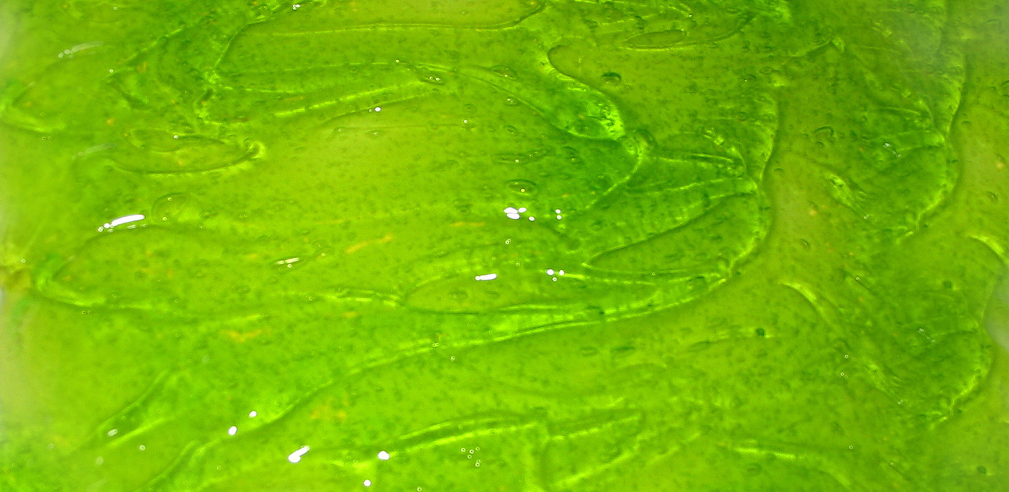
Mood Board

Slide 4
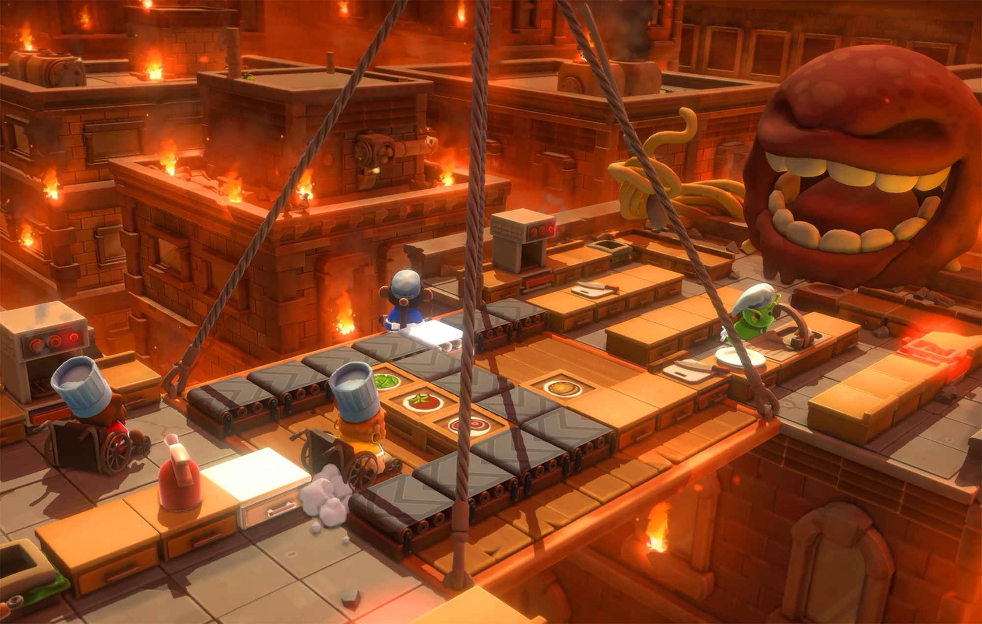
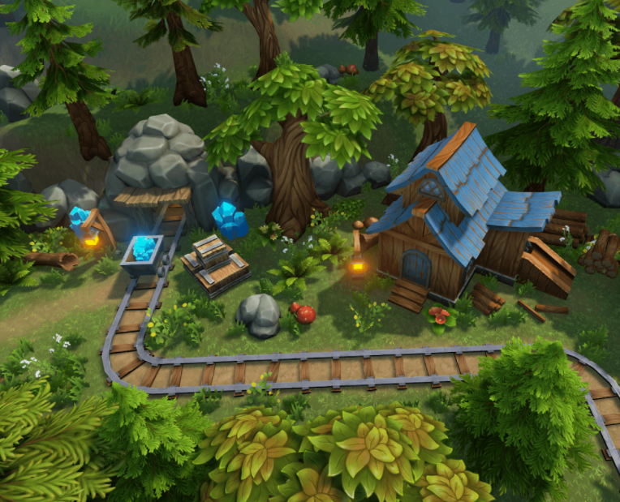
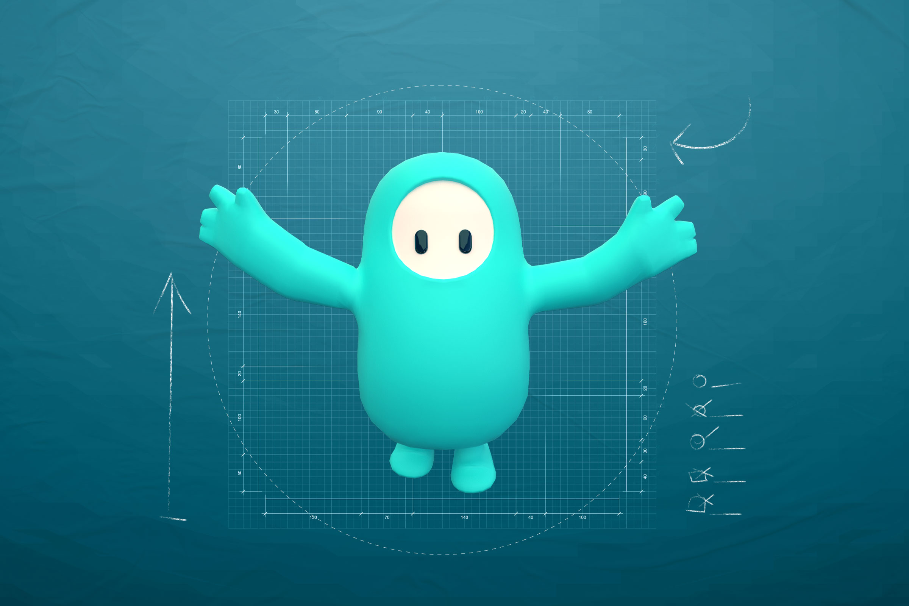
Project Art Style
Hand painted style with few details
Low-poly characters

Slide 5
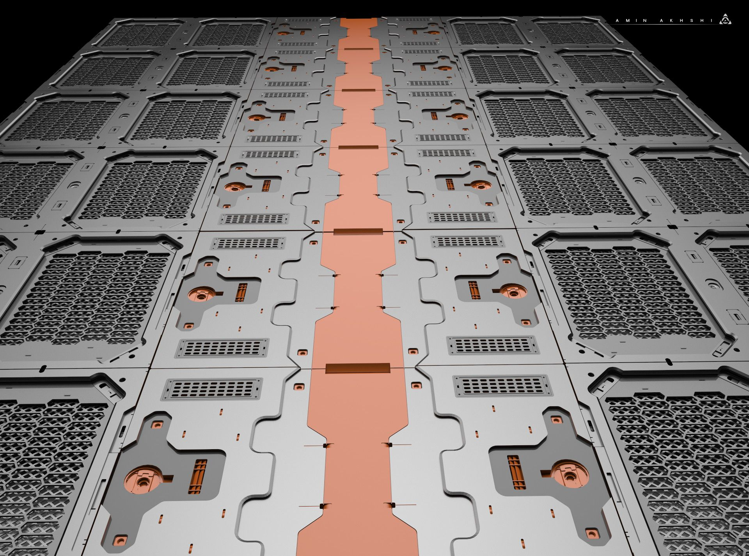
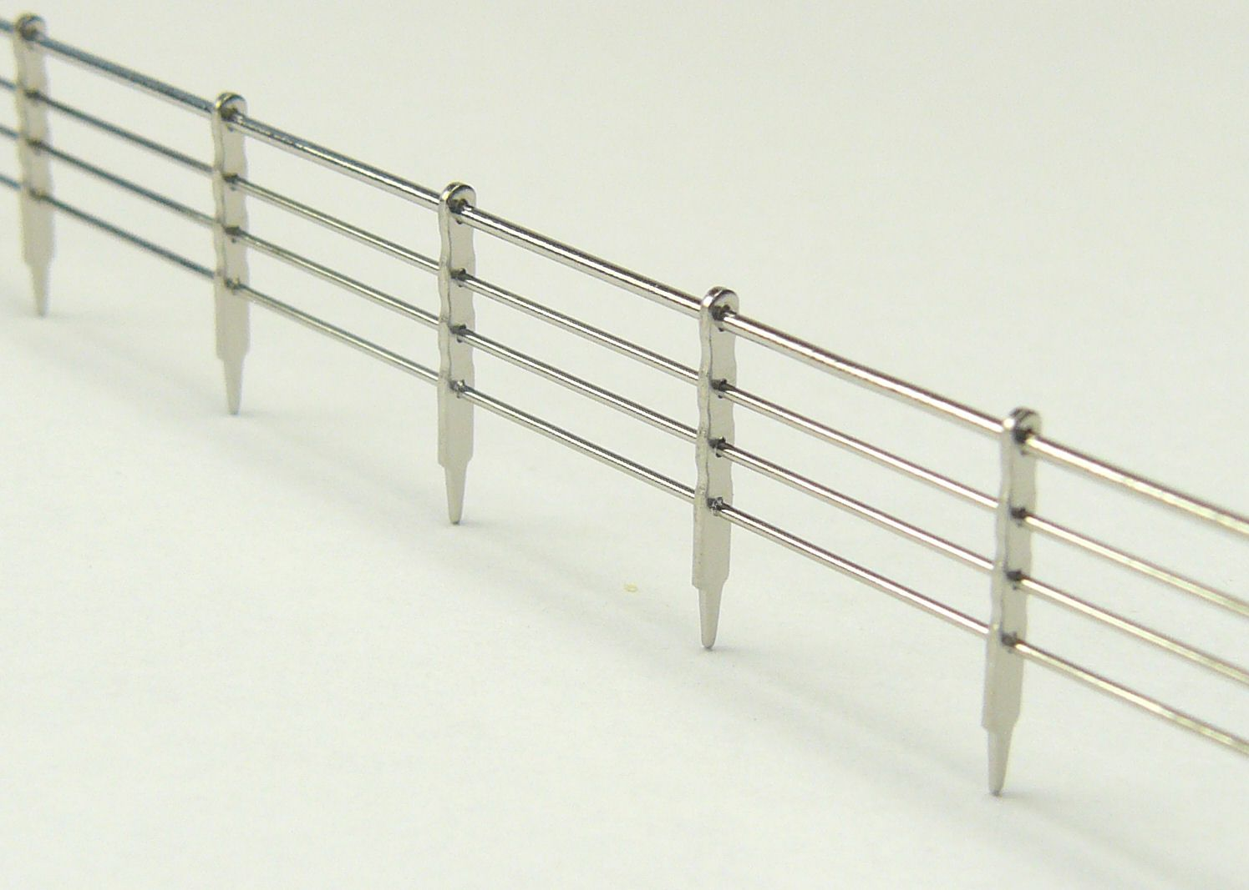
Environment/Atmosphere
Metal textured environment with sci-fi styled aesthetics.
Environment includes floors, guard rails and platforms

Slide 6
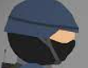
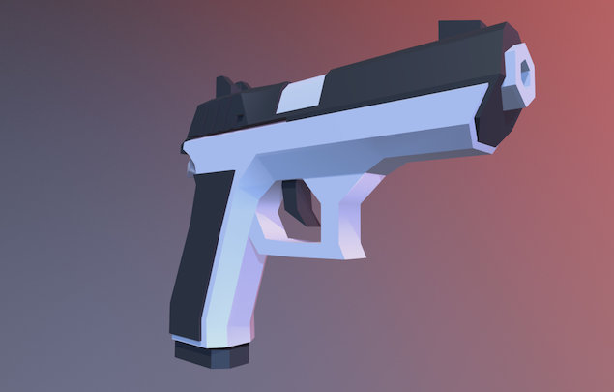
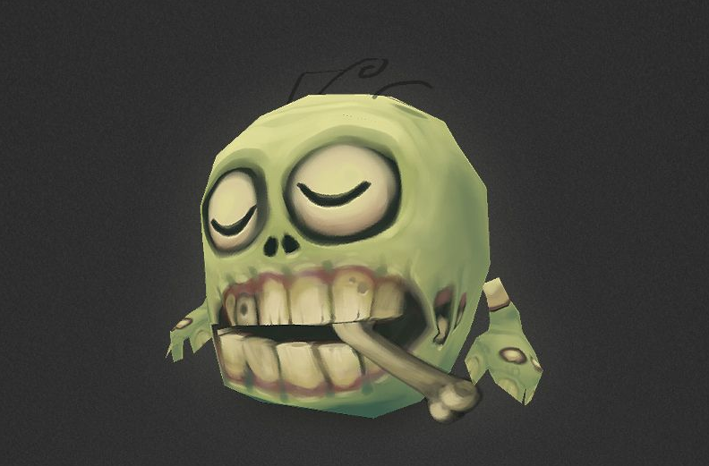
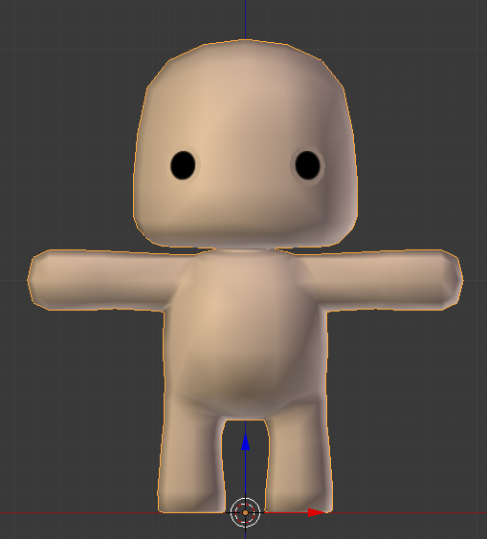
Characters
Helmet on player head
Low-poly gun held by player
Zombie facial features
Consistent body typing across all characters
Large Head on smaller/plump body

Slide 7
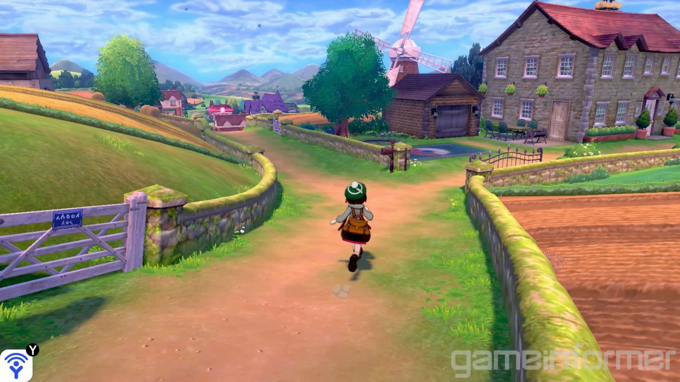
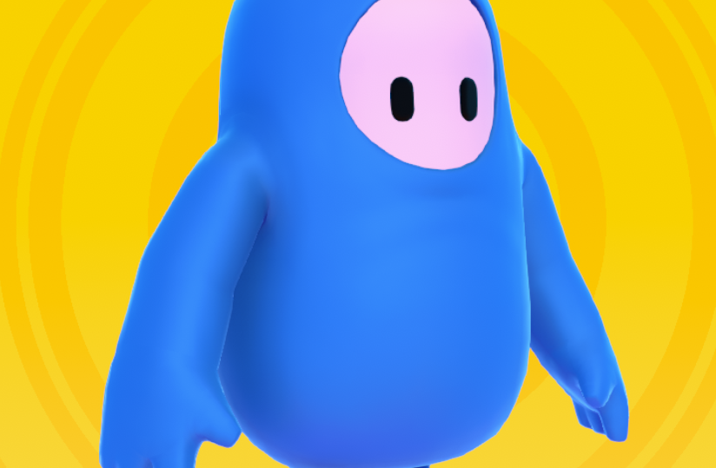
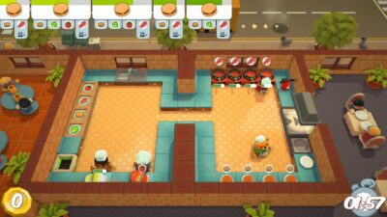
Models/Level of Detail (LOL)
Basic character models
‘Low-quality’ realistic with cartoon-like details for the environment
Maintains hand-painted art style

Slide 8
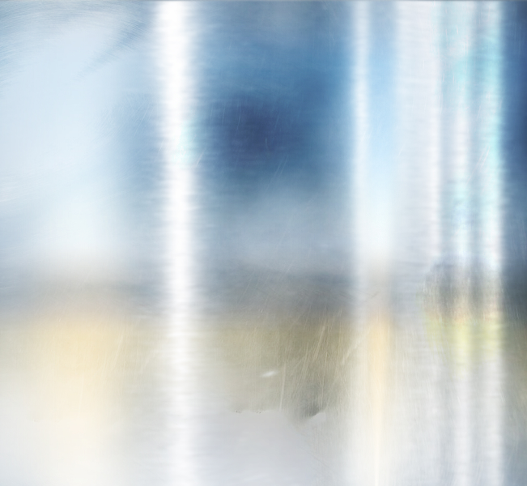
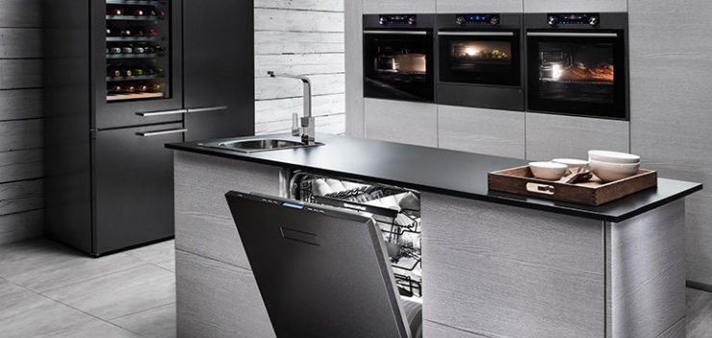
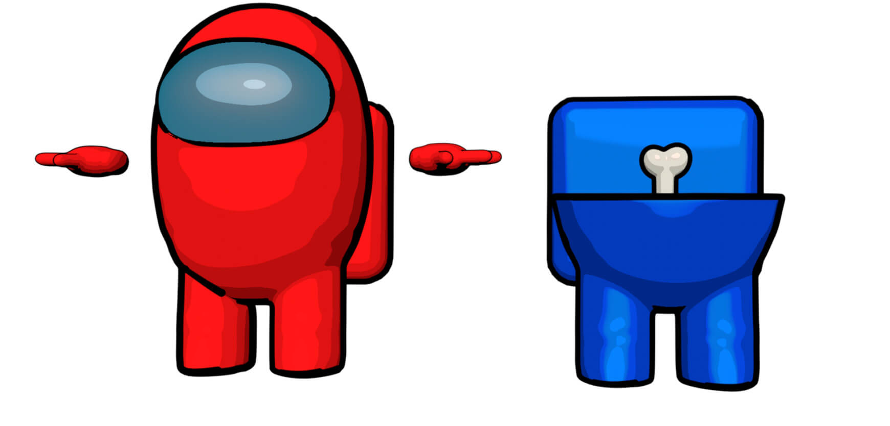
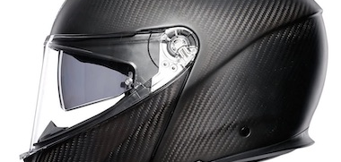
Textures
Smooth reflective/metal texture on most surfaces
NO reflection on characters

Slide 9
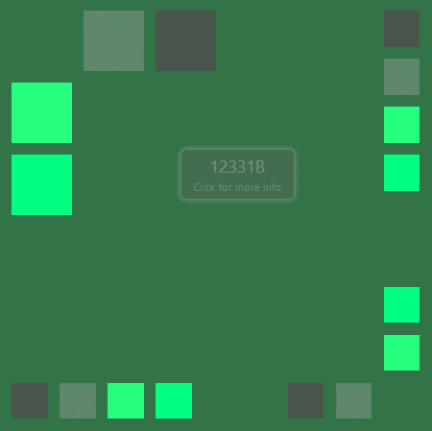
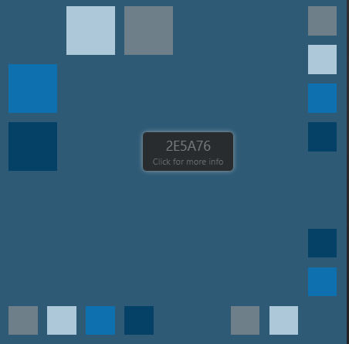
Colour Palette
Dirty/neon green and black FOR ASSETS AND CHARACTERS
Clean blue for sky and environment outside of the level

Slide 10
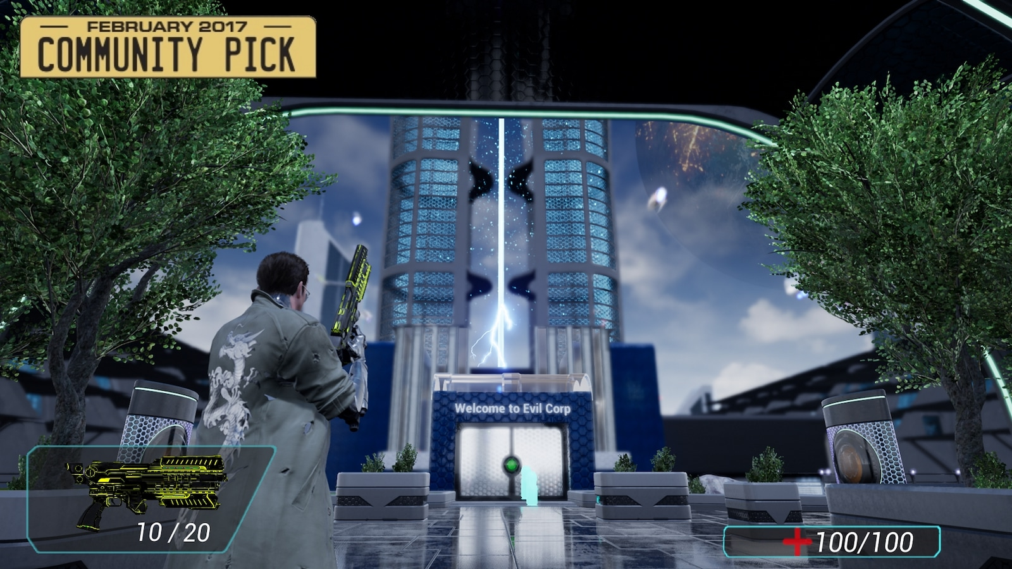
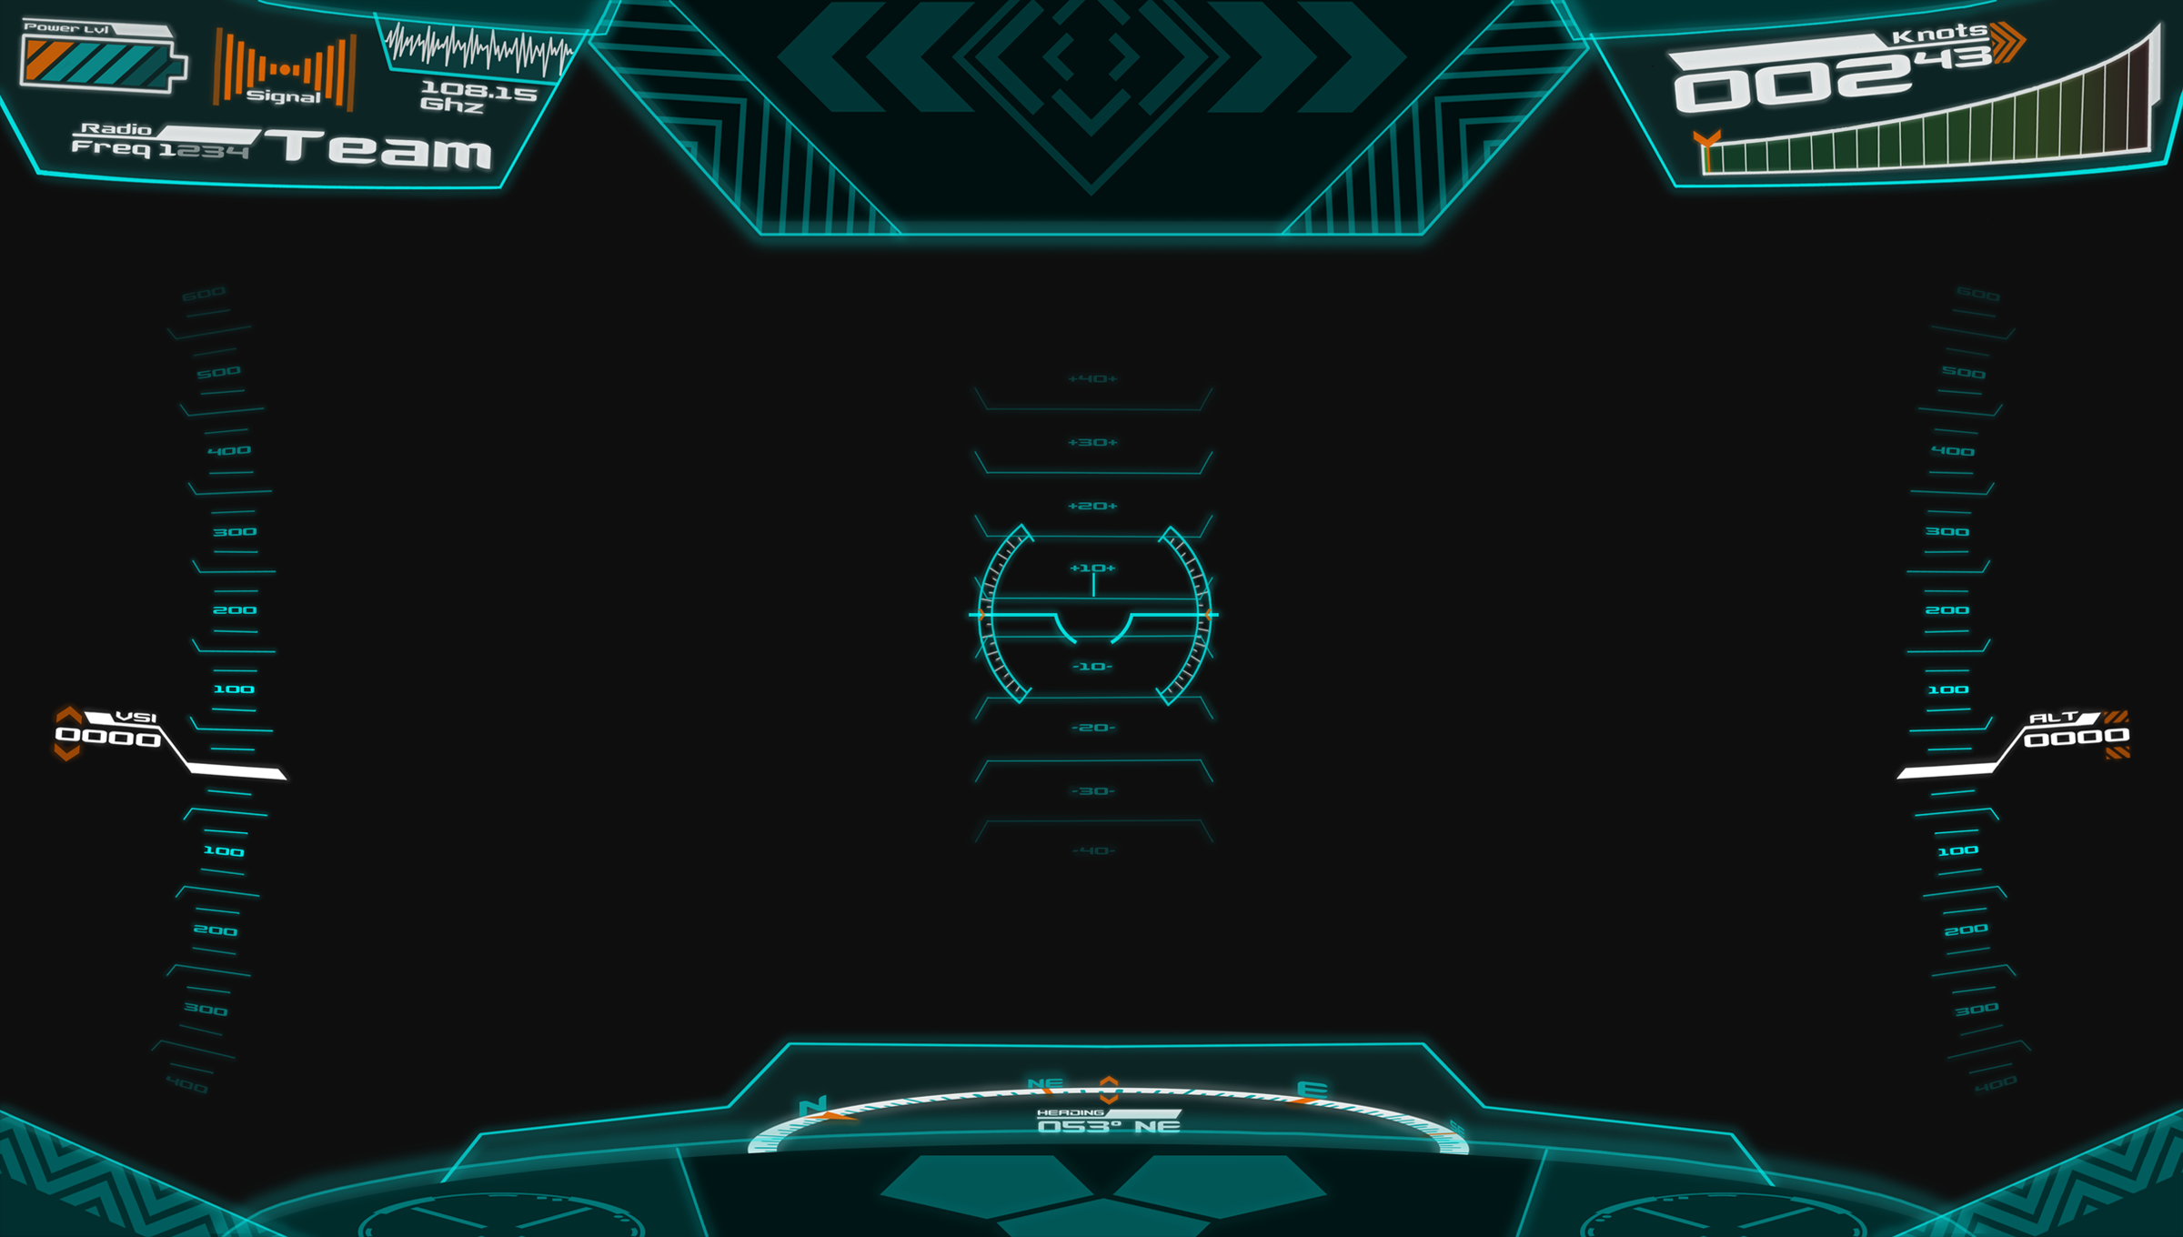
UI Style
Sci-fi UI
Expectant of what would be displayed while wearing a helmet (Diegetic)
Displaying information in bordered polygons
Detailed with straight, coloured lines around camera.

Slide 11

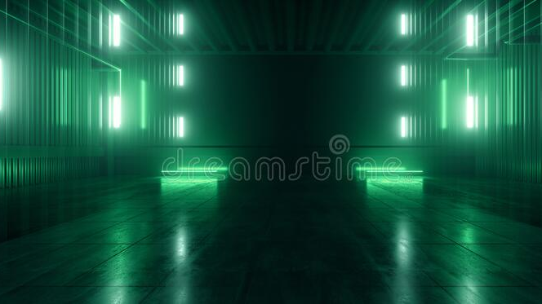
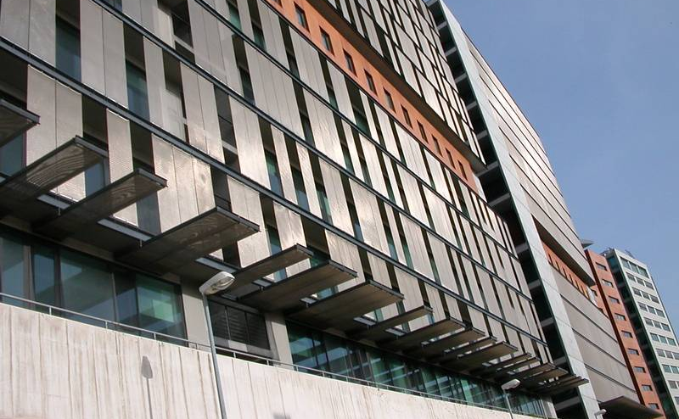
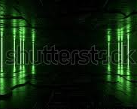
Lighting
Lots of natural lighting
Faint neon green from floor and rails

Slide 12
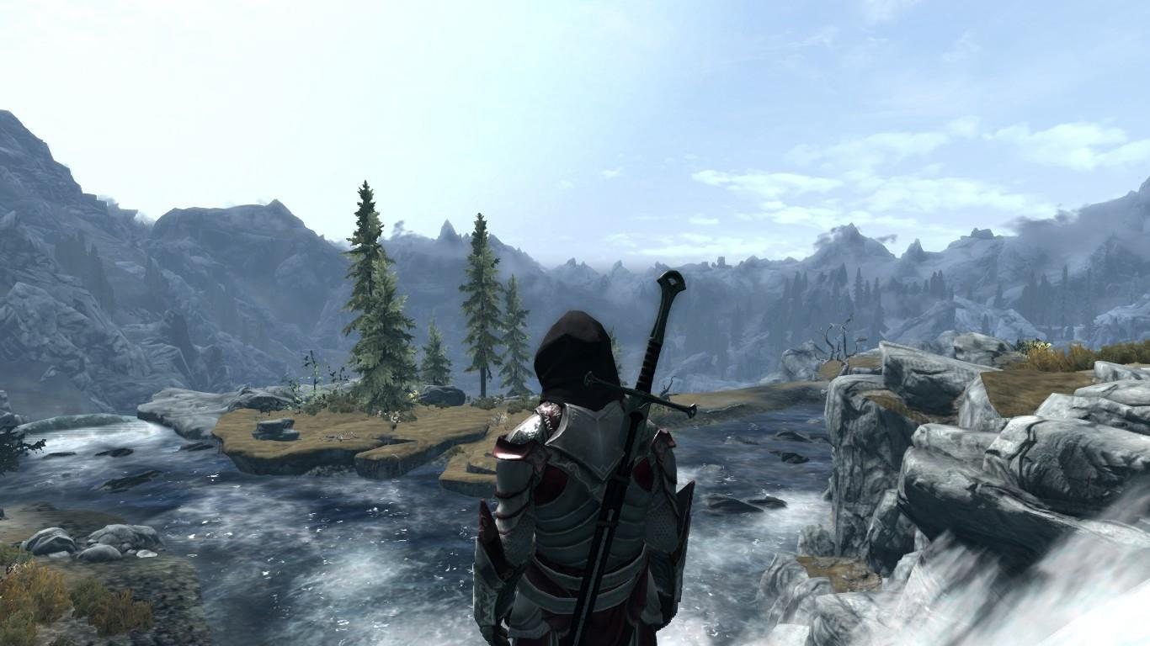
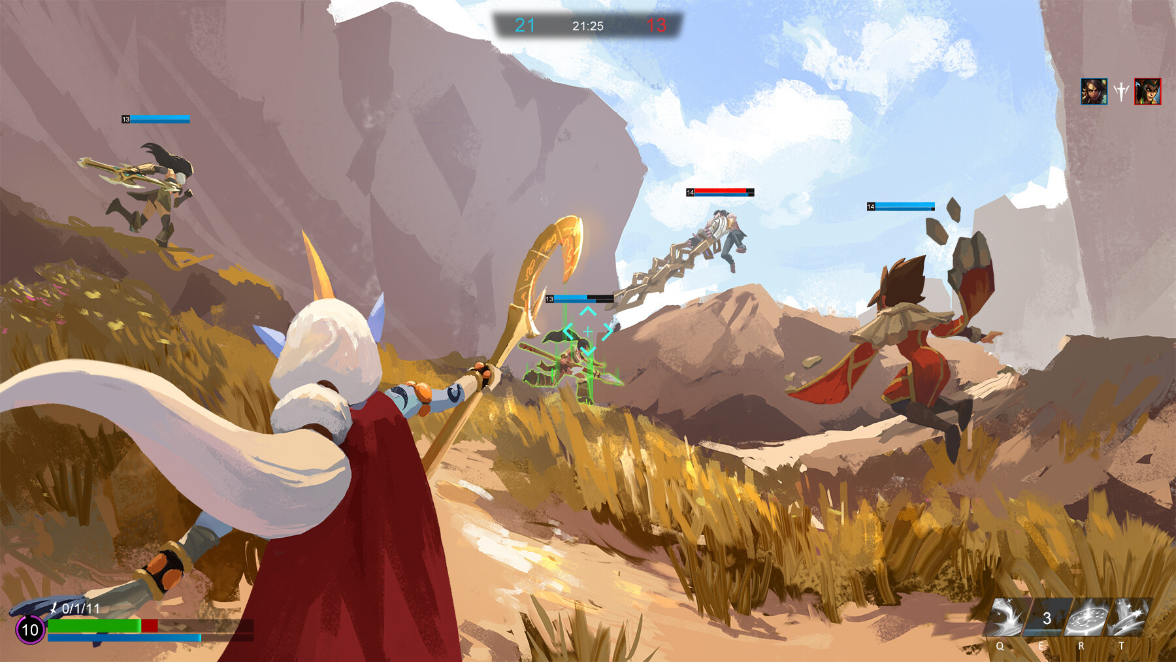
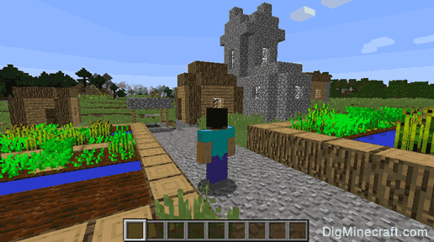
Camera
Third-person perspective

Slide 13
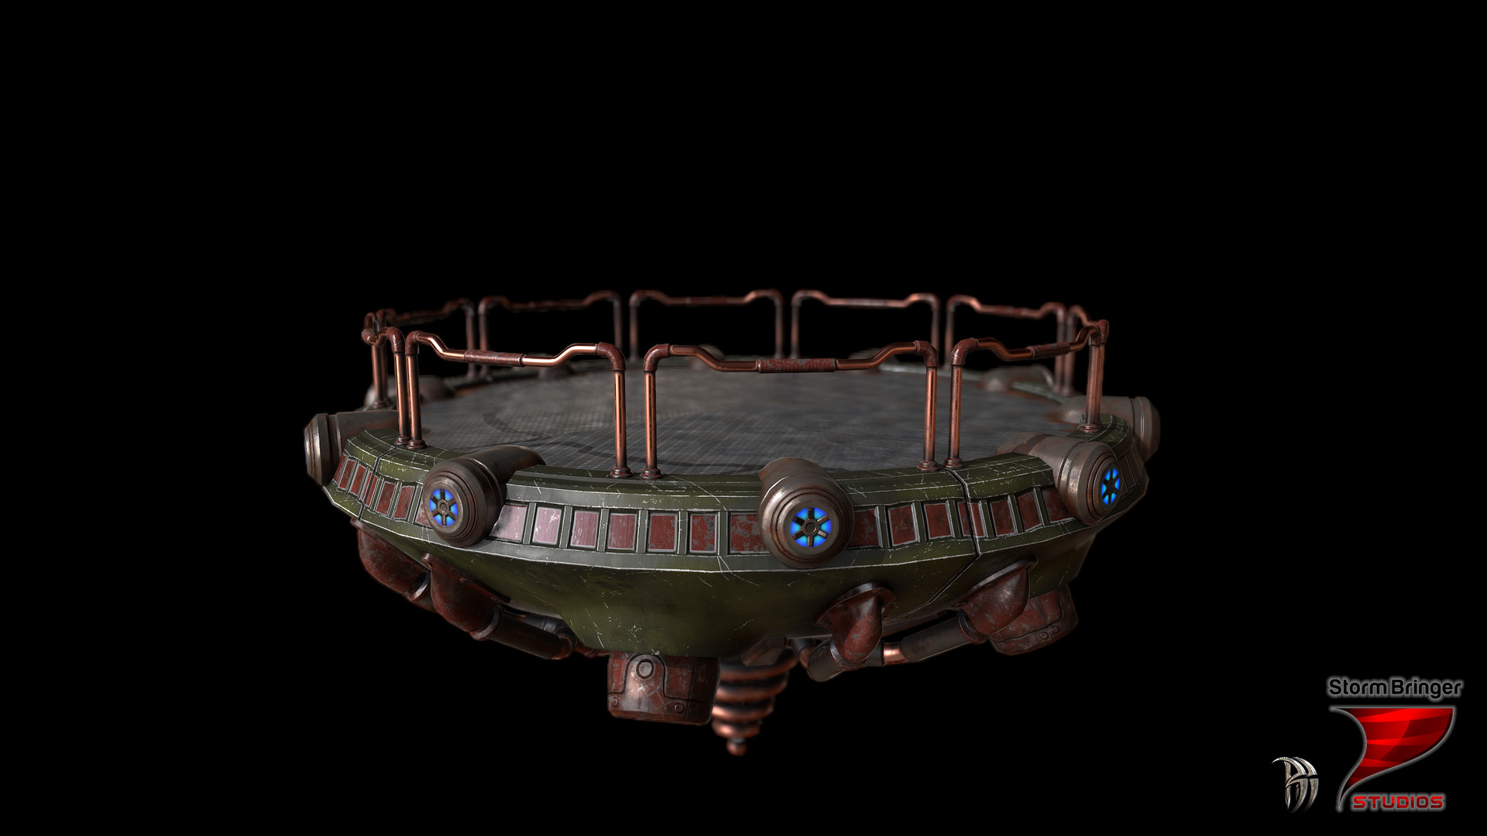
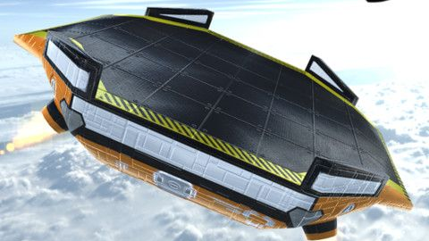
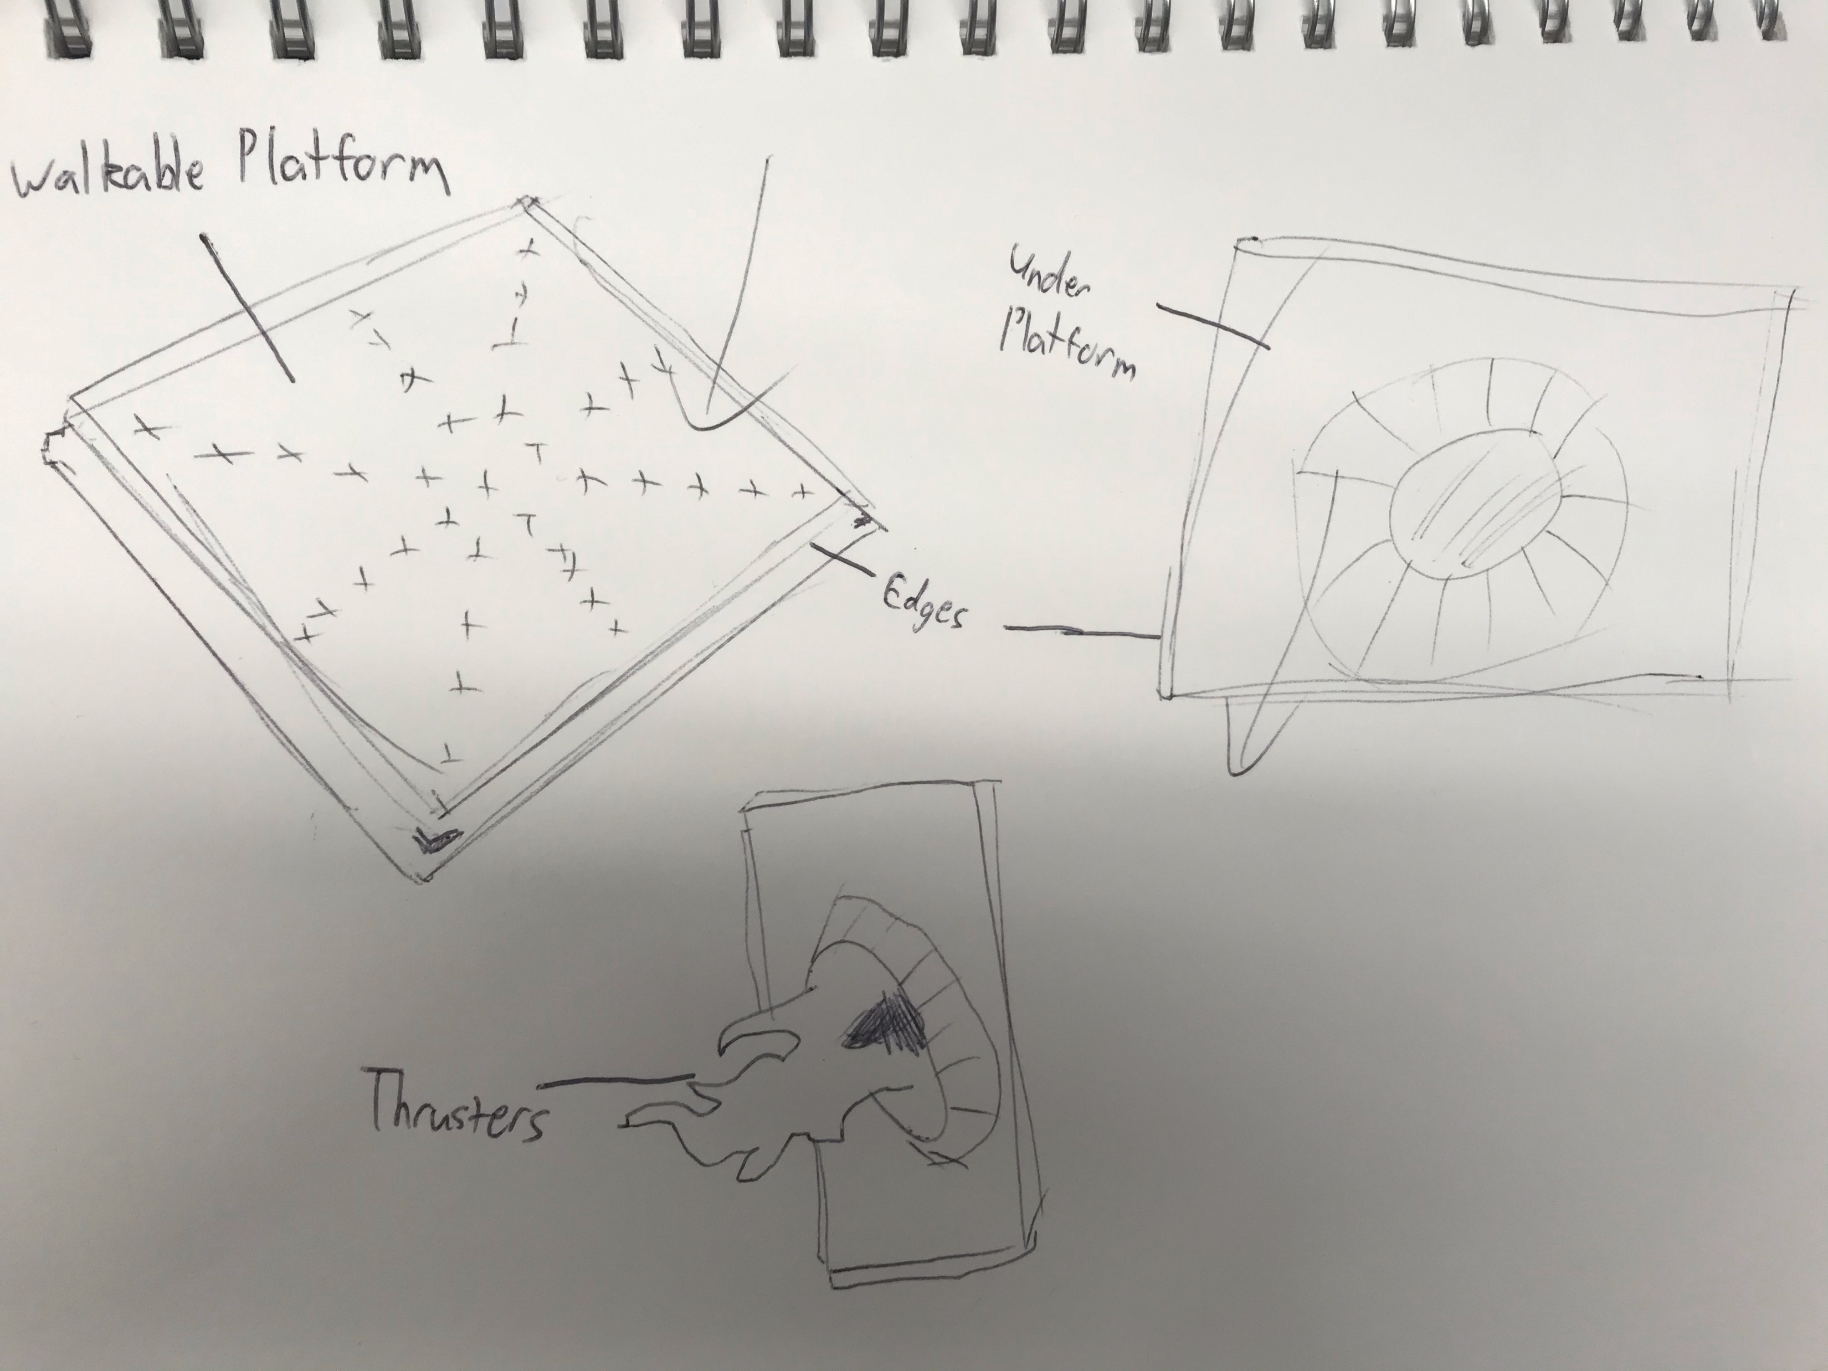
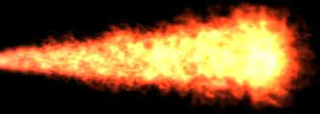
Feature Asset: Concept
A large platform with thrusters on the bottom
Its purpose is to create an additional dynamic by giving the player more options to kill zombies with

Slide 14
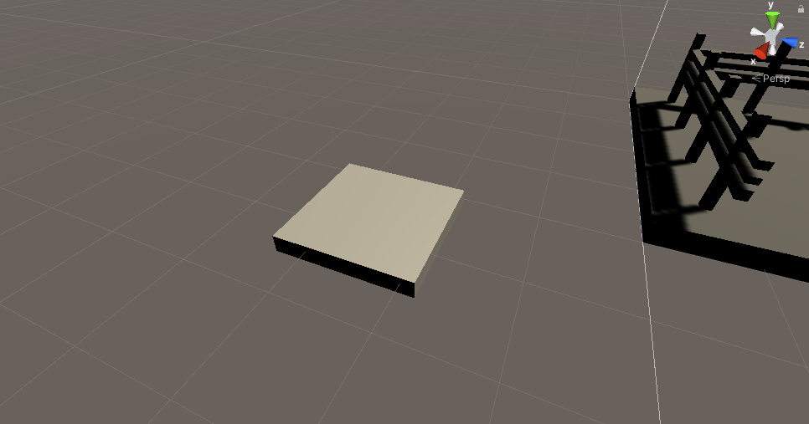
Feature Asset: Grey Box

Slide 15
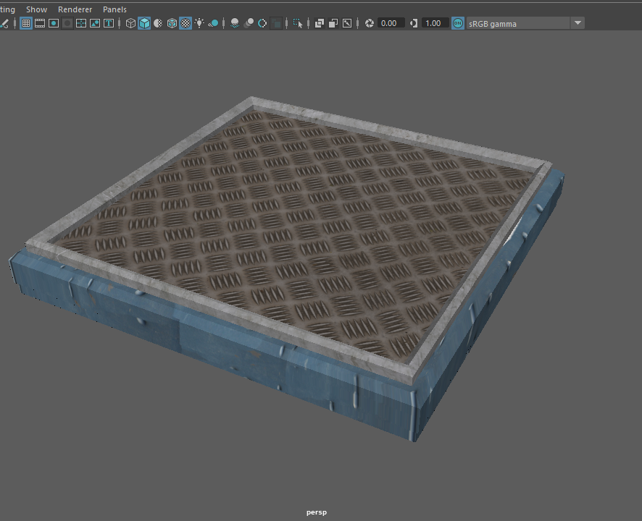
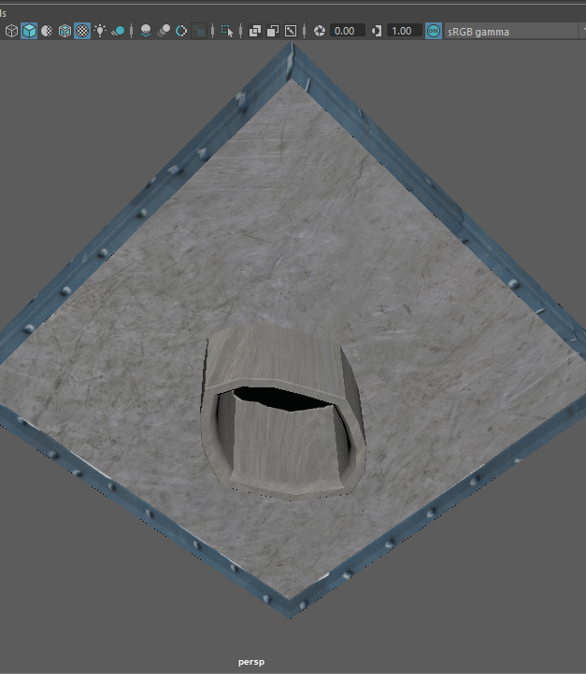
Feature Asset: 1st Pass

Slide 16
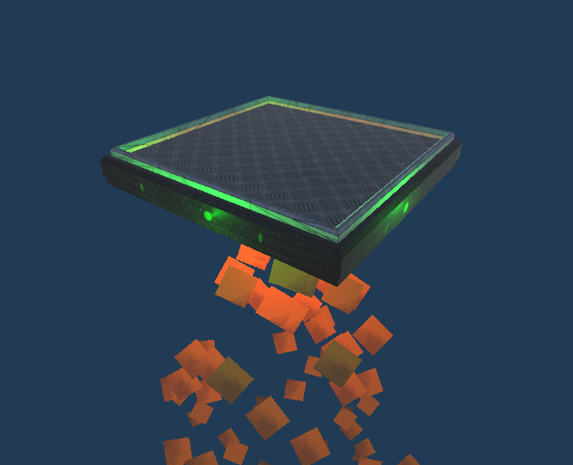
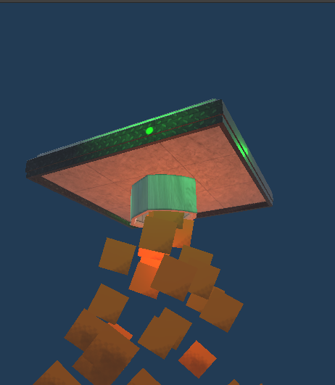
Feature Asset: Final Model (textured)

Slide 17
Design Rules
Assets must be modular, meaning they all have a consistent pivot to which they can be placed in the world.
Consider player and zombie movement when modelling assets which have their elevation affected, being ramps or the moving platform

Slide 18
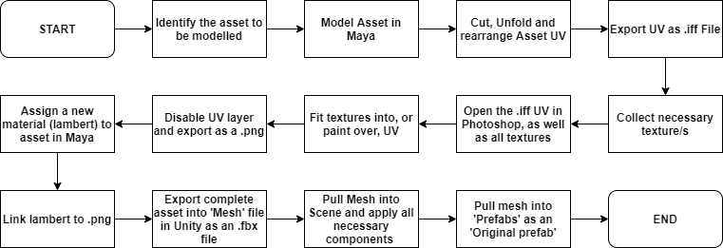
Art Tools
Unity – a common game engine ideal for small scale projects such as this
Maya – the industry standard for modelling/texturing assets for games
Photoshop – a common application allowing for manipulation of UV and textures when used in conjunction with Maya

Slide 19
Technical Guidelines
Platform: PC
Files
Assets: .fbx
Textures: .png
Photoshop: .psd
Naming: Caps for every individual word, no spaces. E.g RailSide

